Slide 1
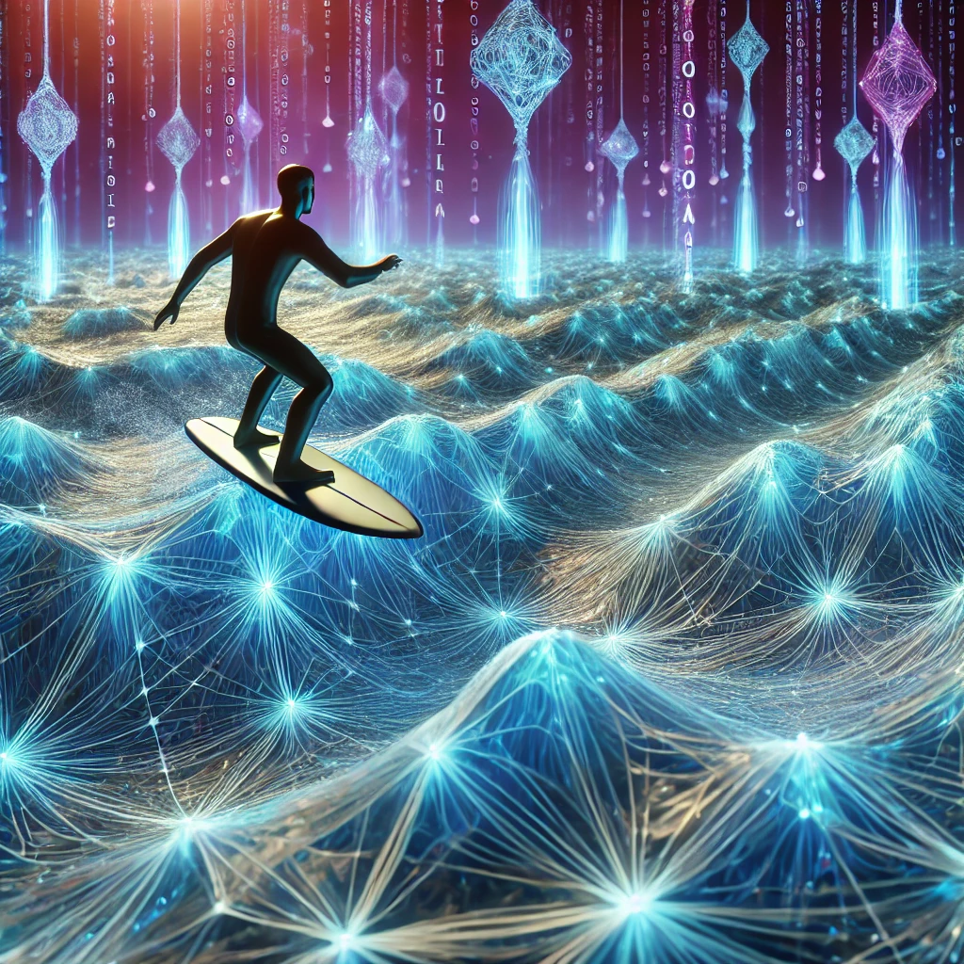

Physics - informed Neural Networks
By: Team Surfers (Akshika, Neel, Amber)
Mentor- Dr. Yangkang Chen

Slide 2

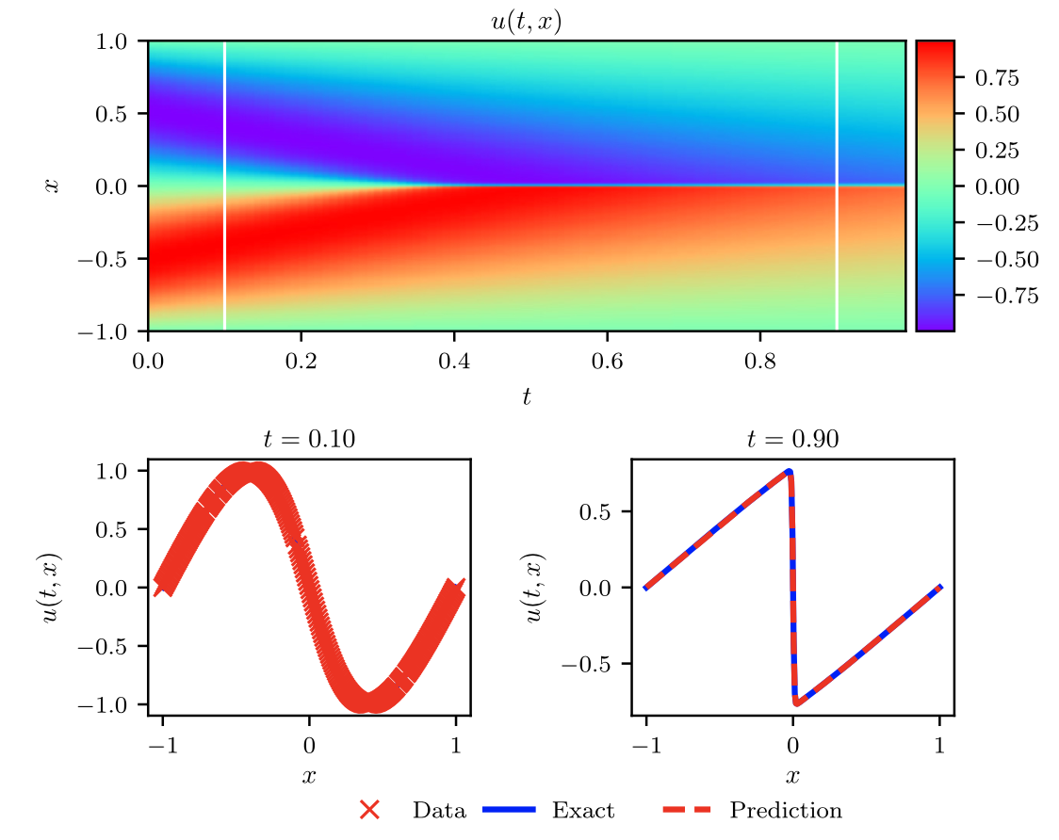
Achieved Goals
Burgers equation example (Figure A.7)
Understand the principles of PINN
Adjust the PINN to explore the sensitivity to parameters
Pie-in-the-sky goal: Wave equation simulation
(Beyond the paper)

Slide 3
Intro: What are Neural Networks?
Burger’s Equation Sensitivity Analysis
Conclusion
PINN vs Normal Neural Networks?
PINN for the Wave Equation

Slide 4
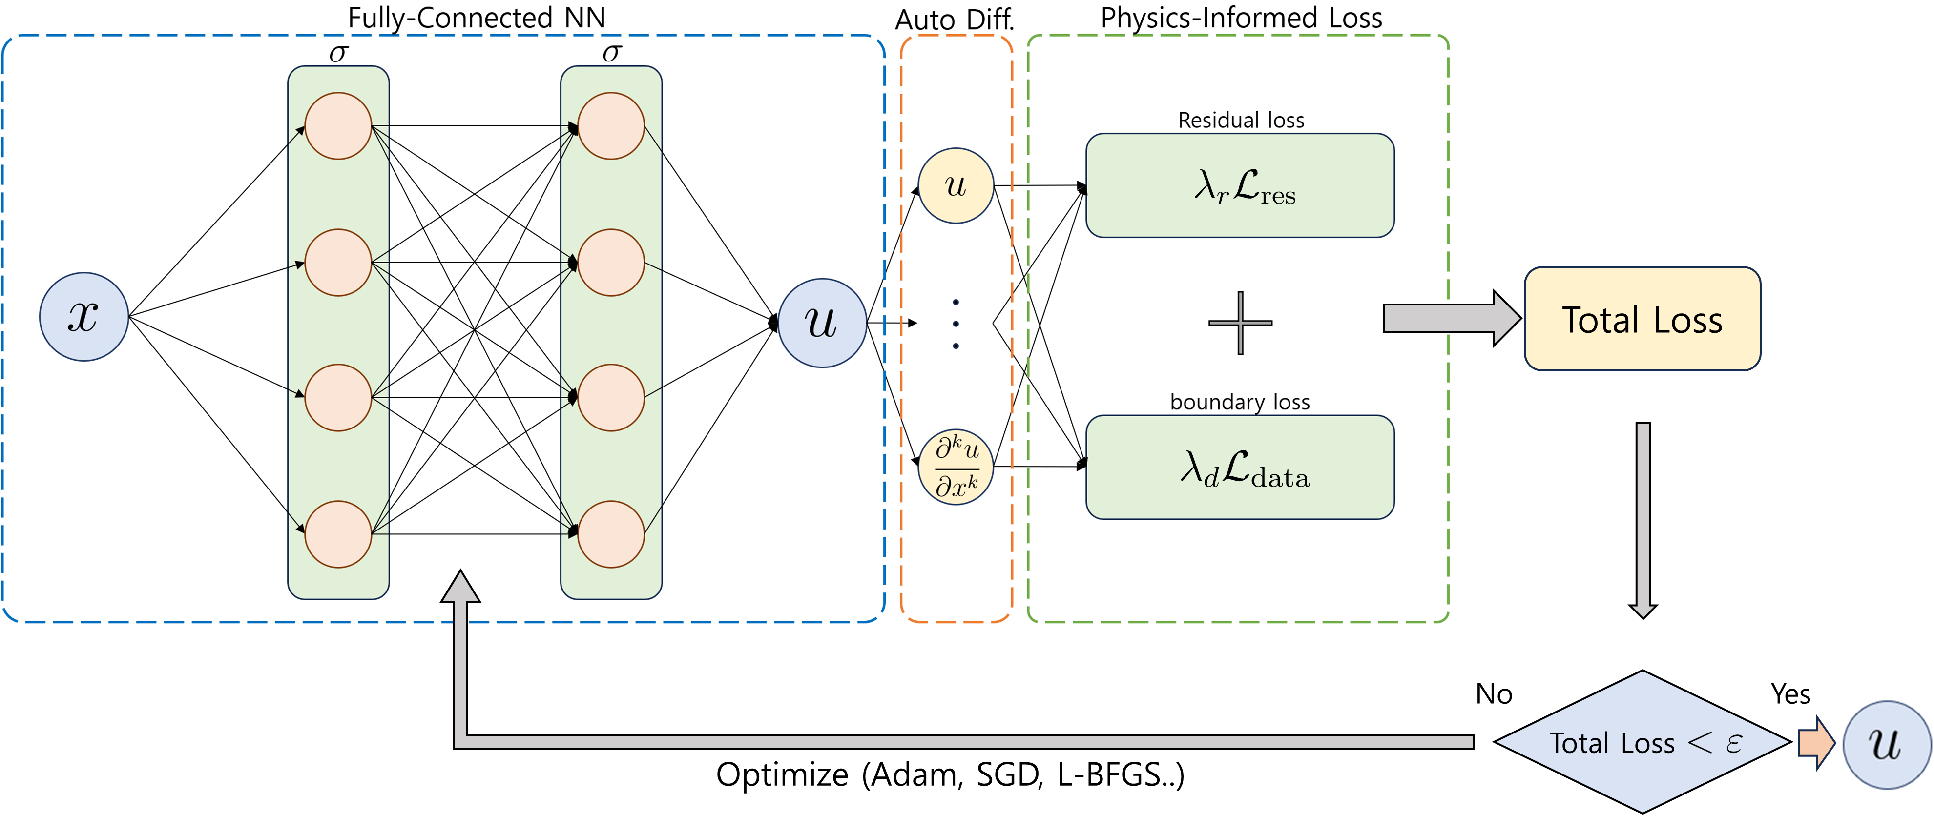
PINN vs Normal Neural Networks?

Slide 5
Intro: What are Neural Networks?
Conclusion
Burger’s Equation Sensitivity Analysis
PINN vs Normal Neural Networks?
PINN for the Wave Equation

Slide 6
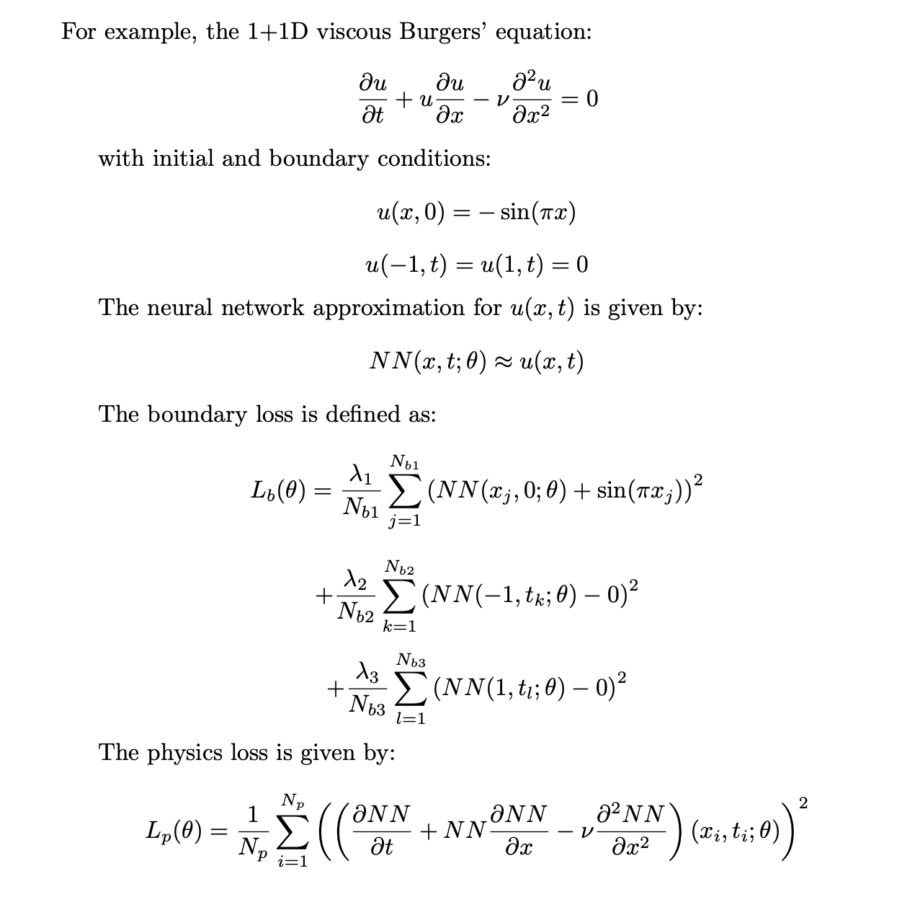
Burger’s Equation

Slide 7
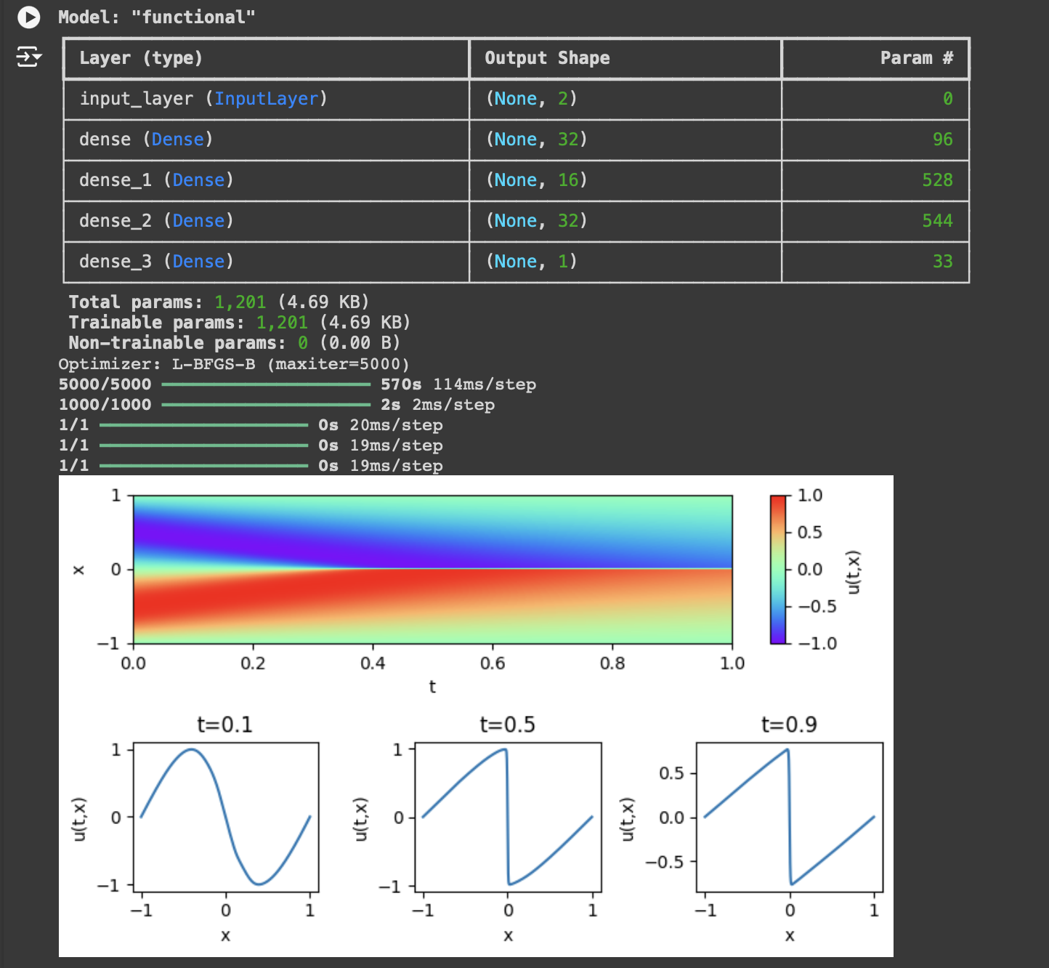
CPU
He normal initializer to initialize the weights to the input layer
Activation function = tanh

Slide 8
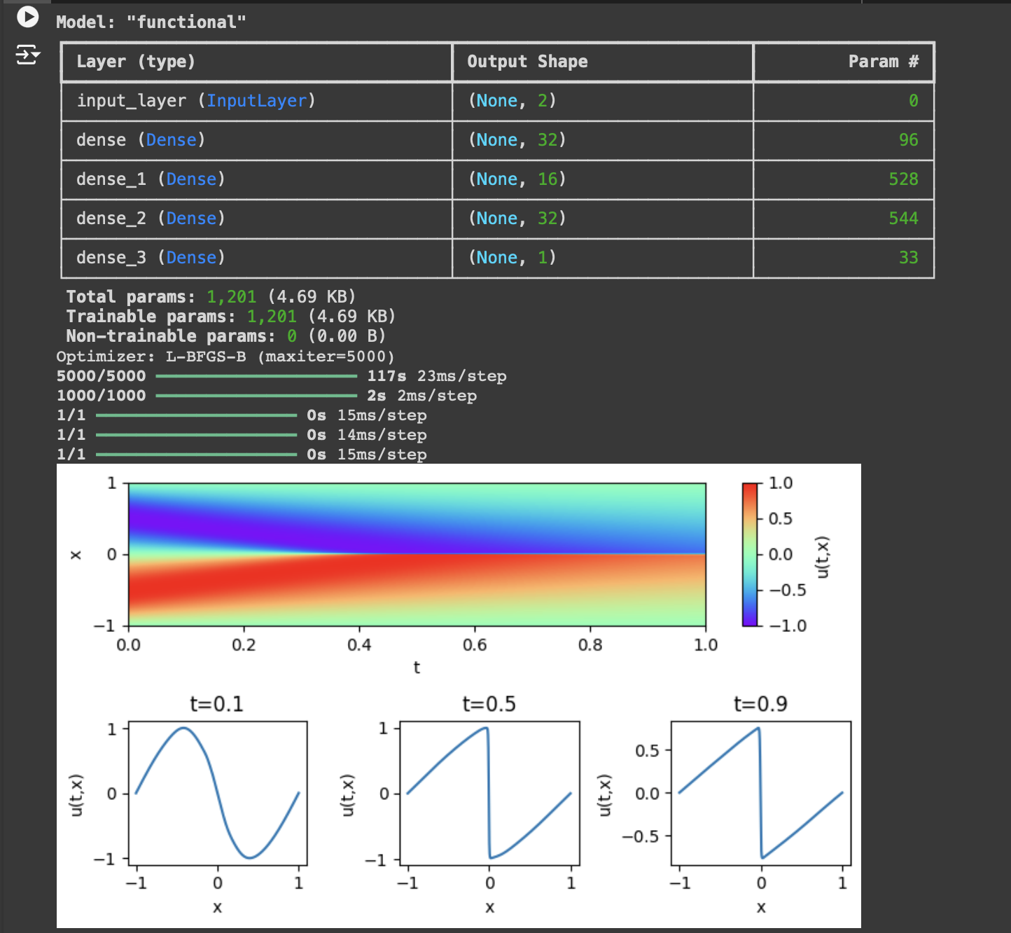
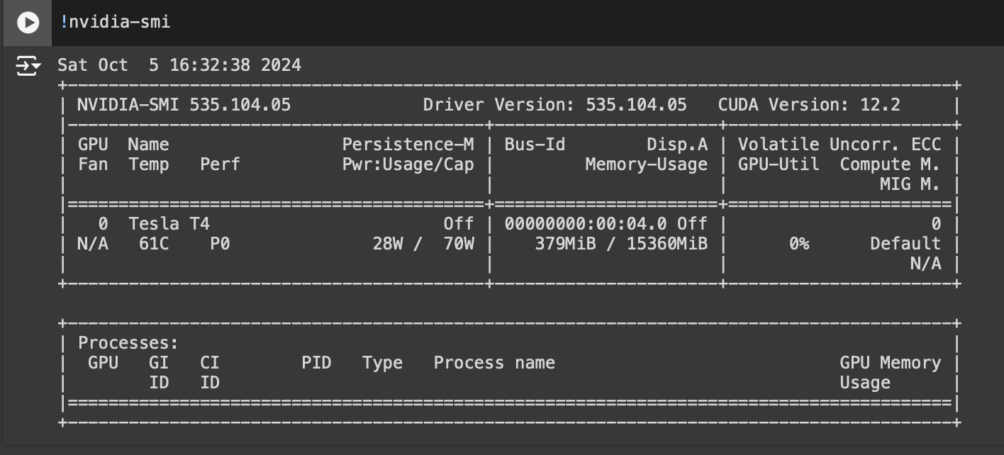
GPU

Slide 9
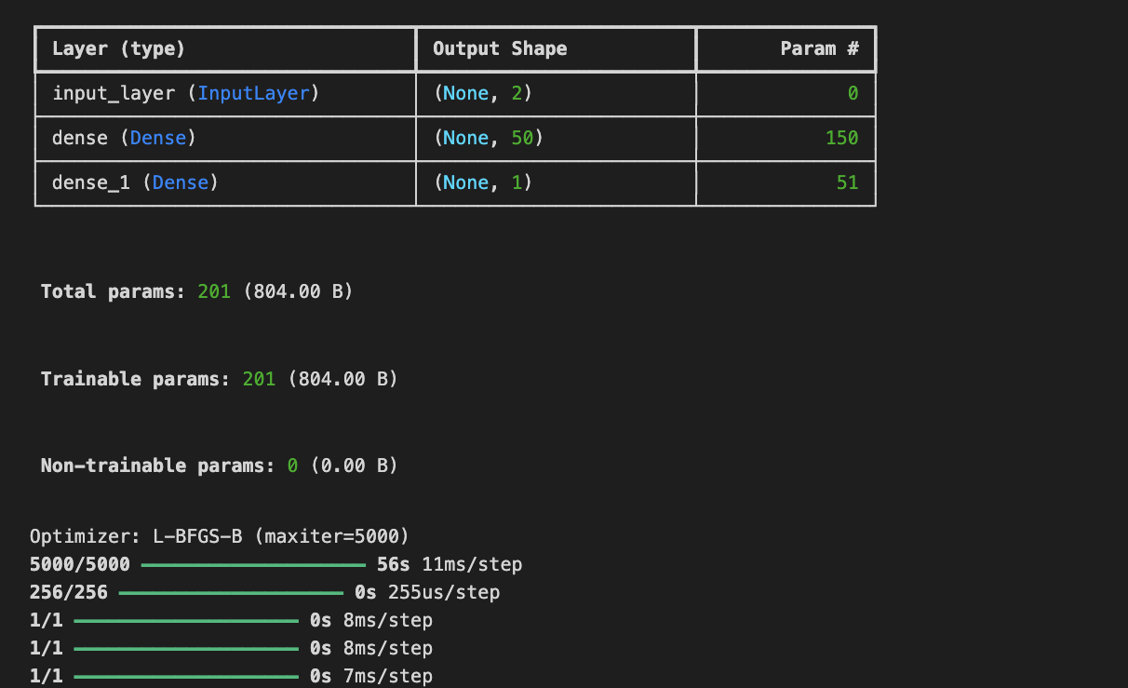
Shallow neural network

Slide 10
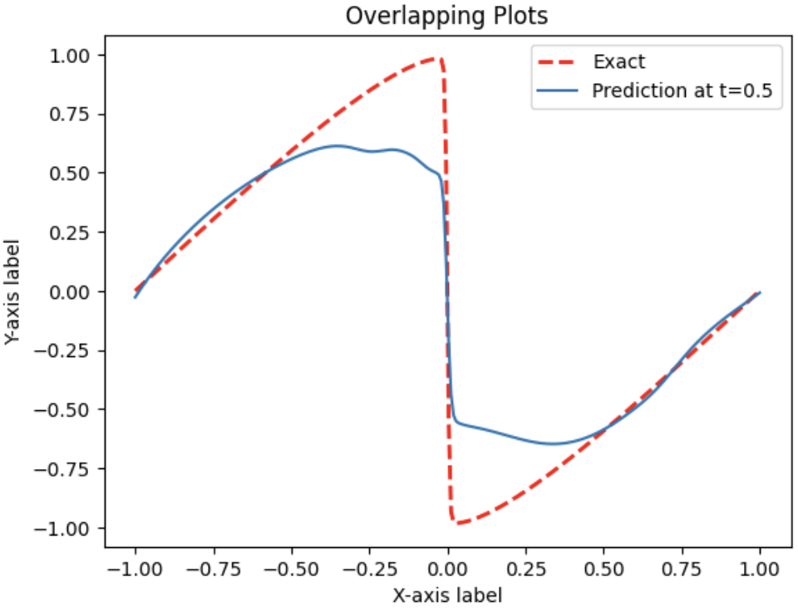
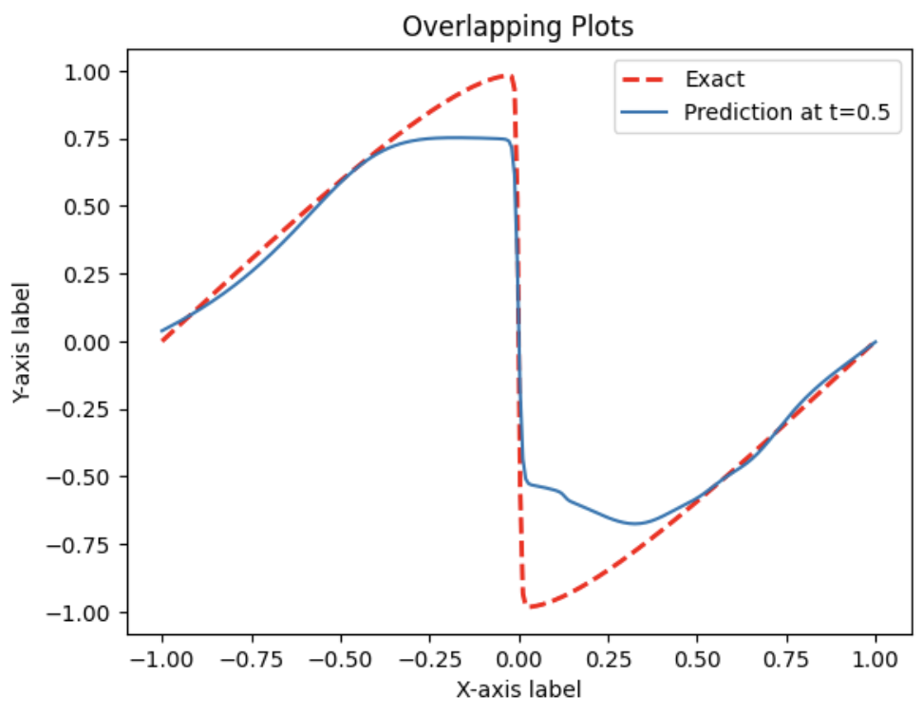
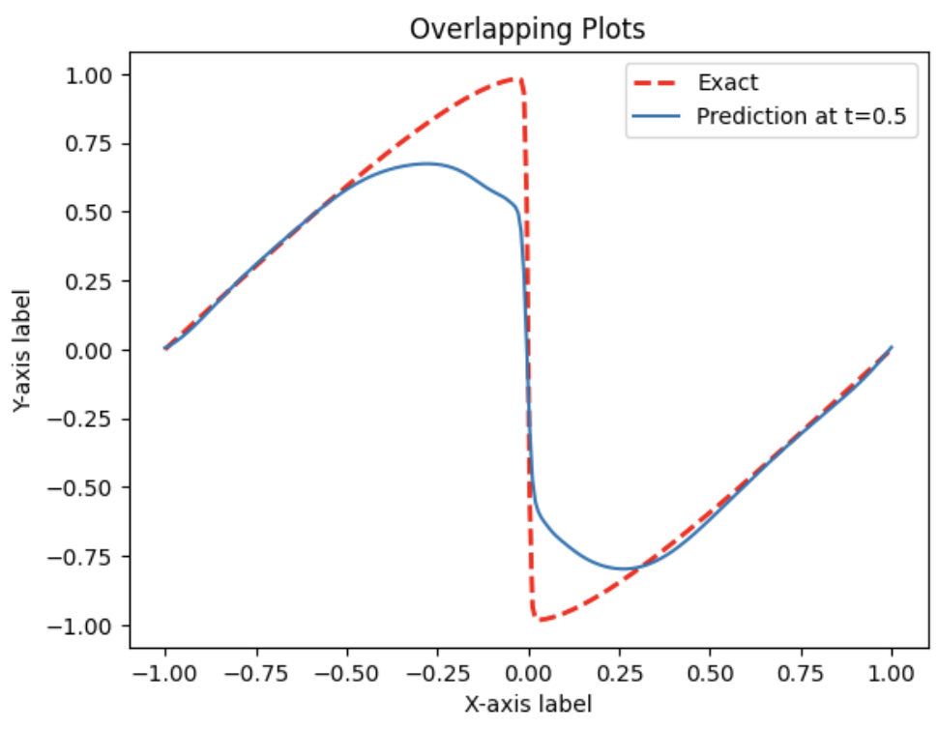
NEURONS:: 16
NEURONS:: 32
NEURONS:: 64
(MSE): 0.03824757336252923
(MSE): 0.025659515619518954
(MSE): 0.022908405777260228
DECREASING MSE

Slide 11
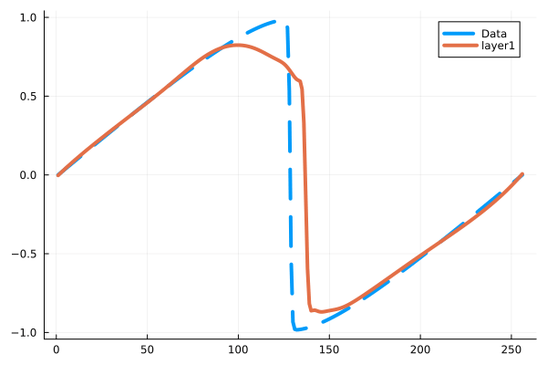
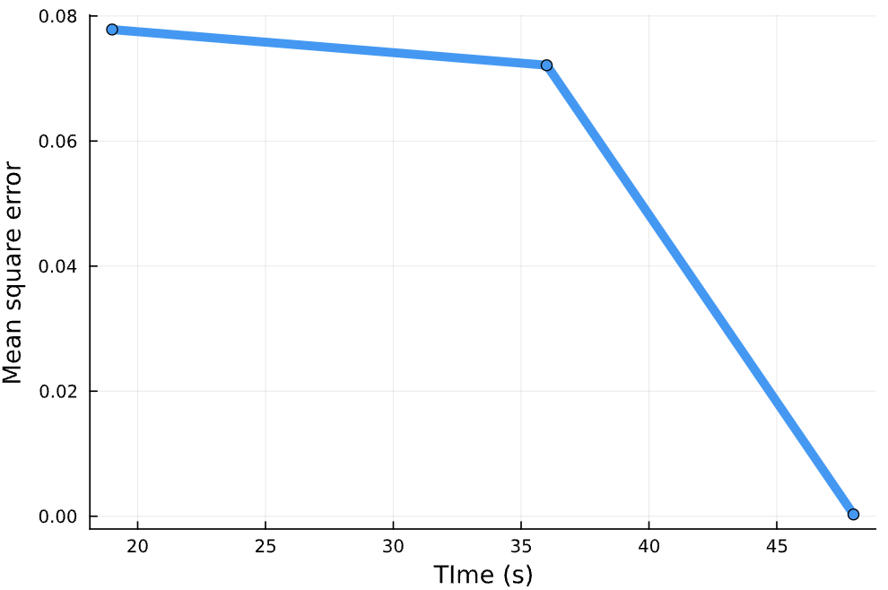
#NEURONS = 50
Layer 1
Layer 2
Layer 3

Slide 12
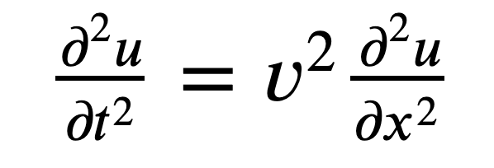
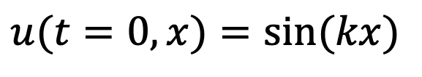
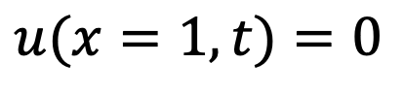
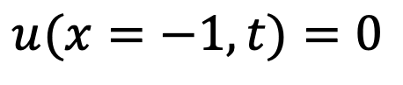
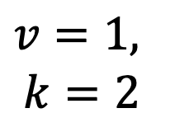
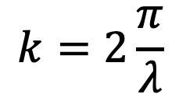
Wave Equation
Initial Condition
Dirichlet BC
$$u(t=0, x)=sin⁡(kx)$$
$$u(x=−1, t)=0$$
$$k=2\frac{π}{λ}$$
$$u(x=1, t)=0$$
Standing wave
$$v=1,$$
$$k=2$$

Slide 13
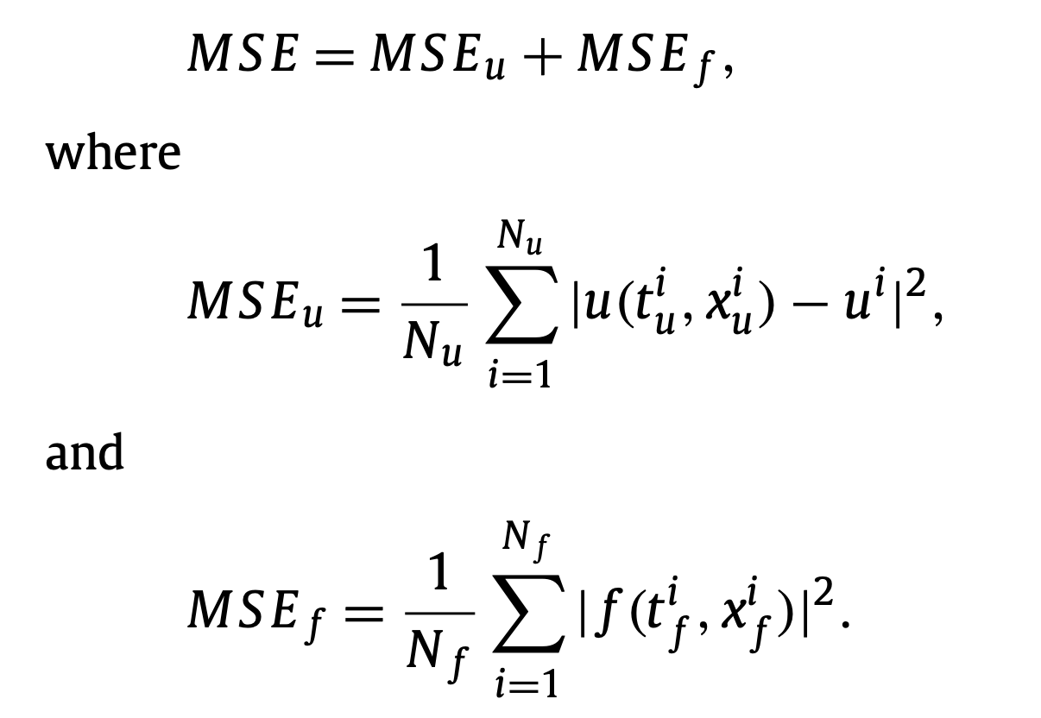
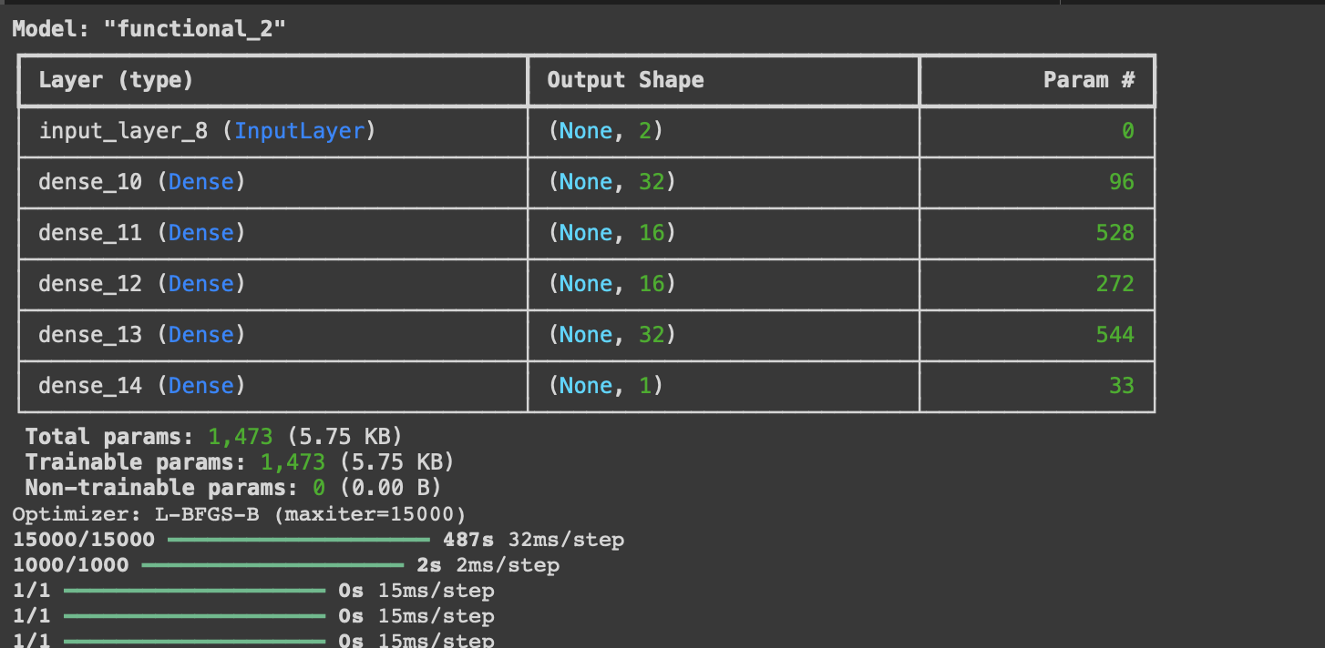
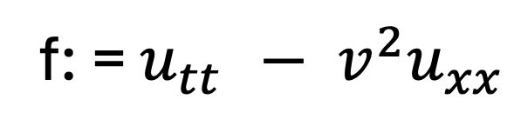
Wave Equation
What have we changed? – Governing Equation
f: = $u_{tt }− v^{2}u_{xx}$
Activation function = tanh
L-BFGS-B = optimizer
No of iterations = 15000

Slide 14
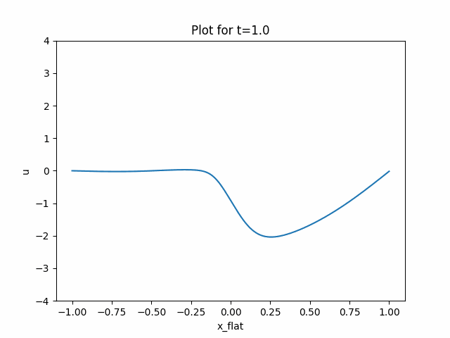
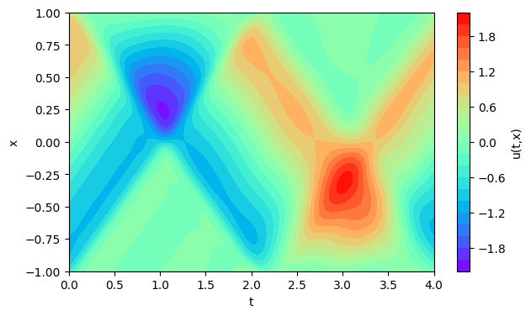
Dirichlet Boundary Condition

Slide 15
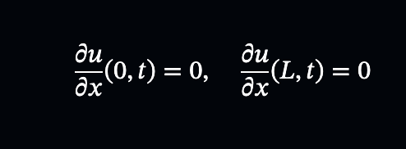
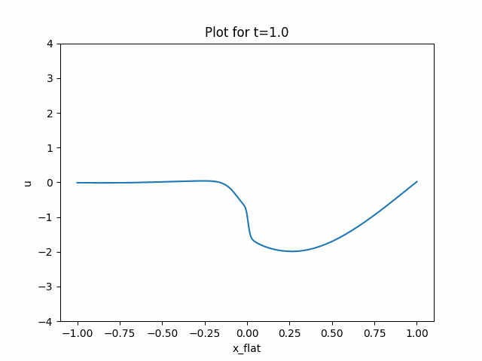

Neumann’s Boundary Condition

Slide 16
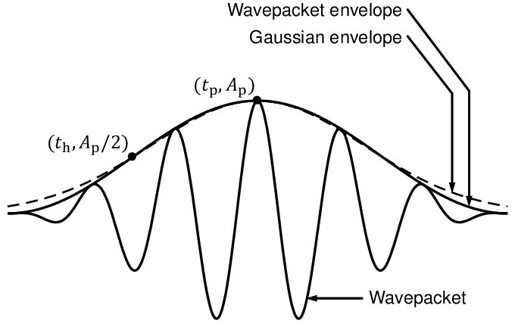
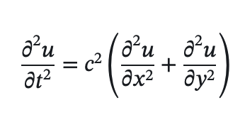
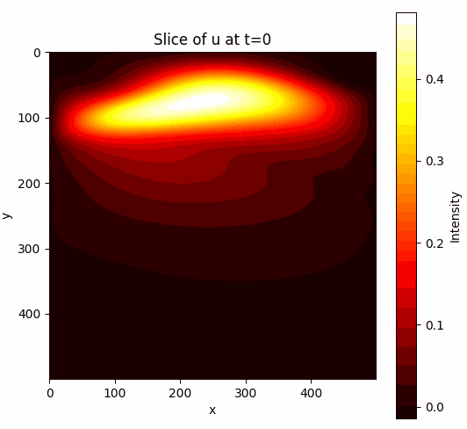
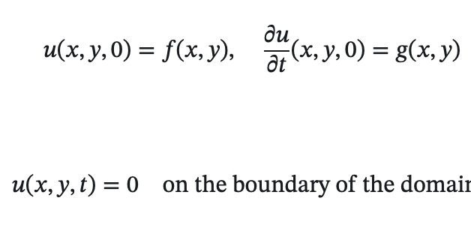
2D Wave Equation

Slide 17

CONCLUSION
Understood the working of PINNs – It incorporated PDE in Neural Network Loss Function
We are approximating the functional approximation of the solution using a mesh free approach.
We solved Burgers’ Equation using PINNs and reproduced results of Raissi et. al., 2019
We applied PINN to solve 1D wave Equation
Dirichlet Boundary Conditions
Neumann Boundary Conditions
We applied PINN to solve 2D wave Equation
Created GitHub repository for reproducible research.
https://github.com/arohatgi29/Team_Surfers_Geoscience_Hackathon2024

Slide 18
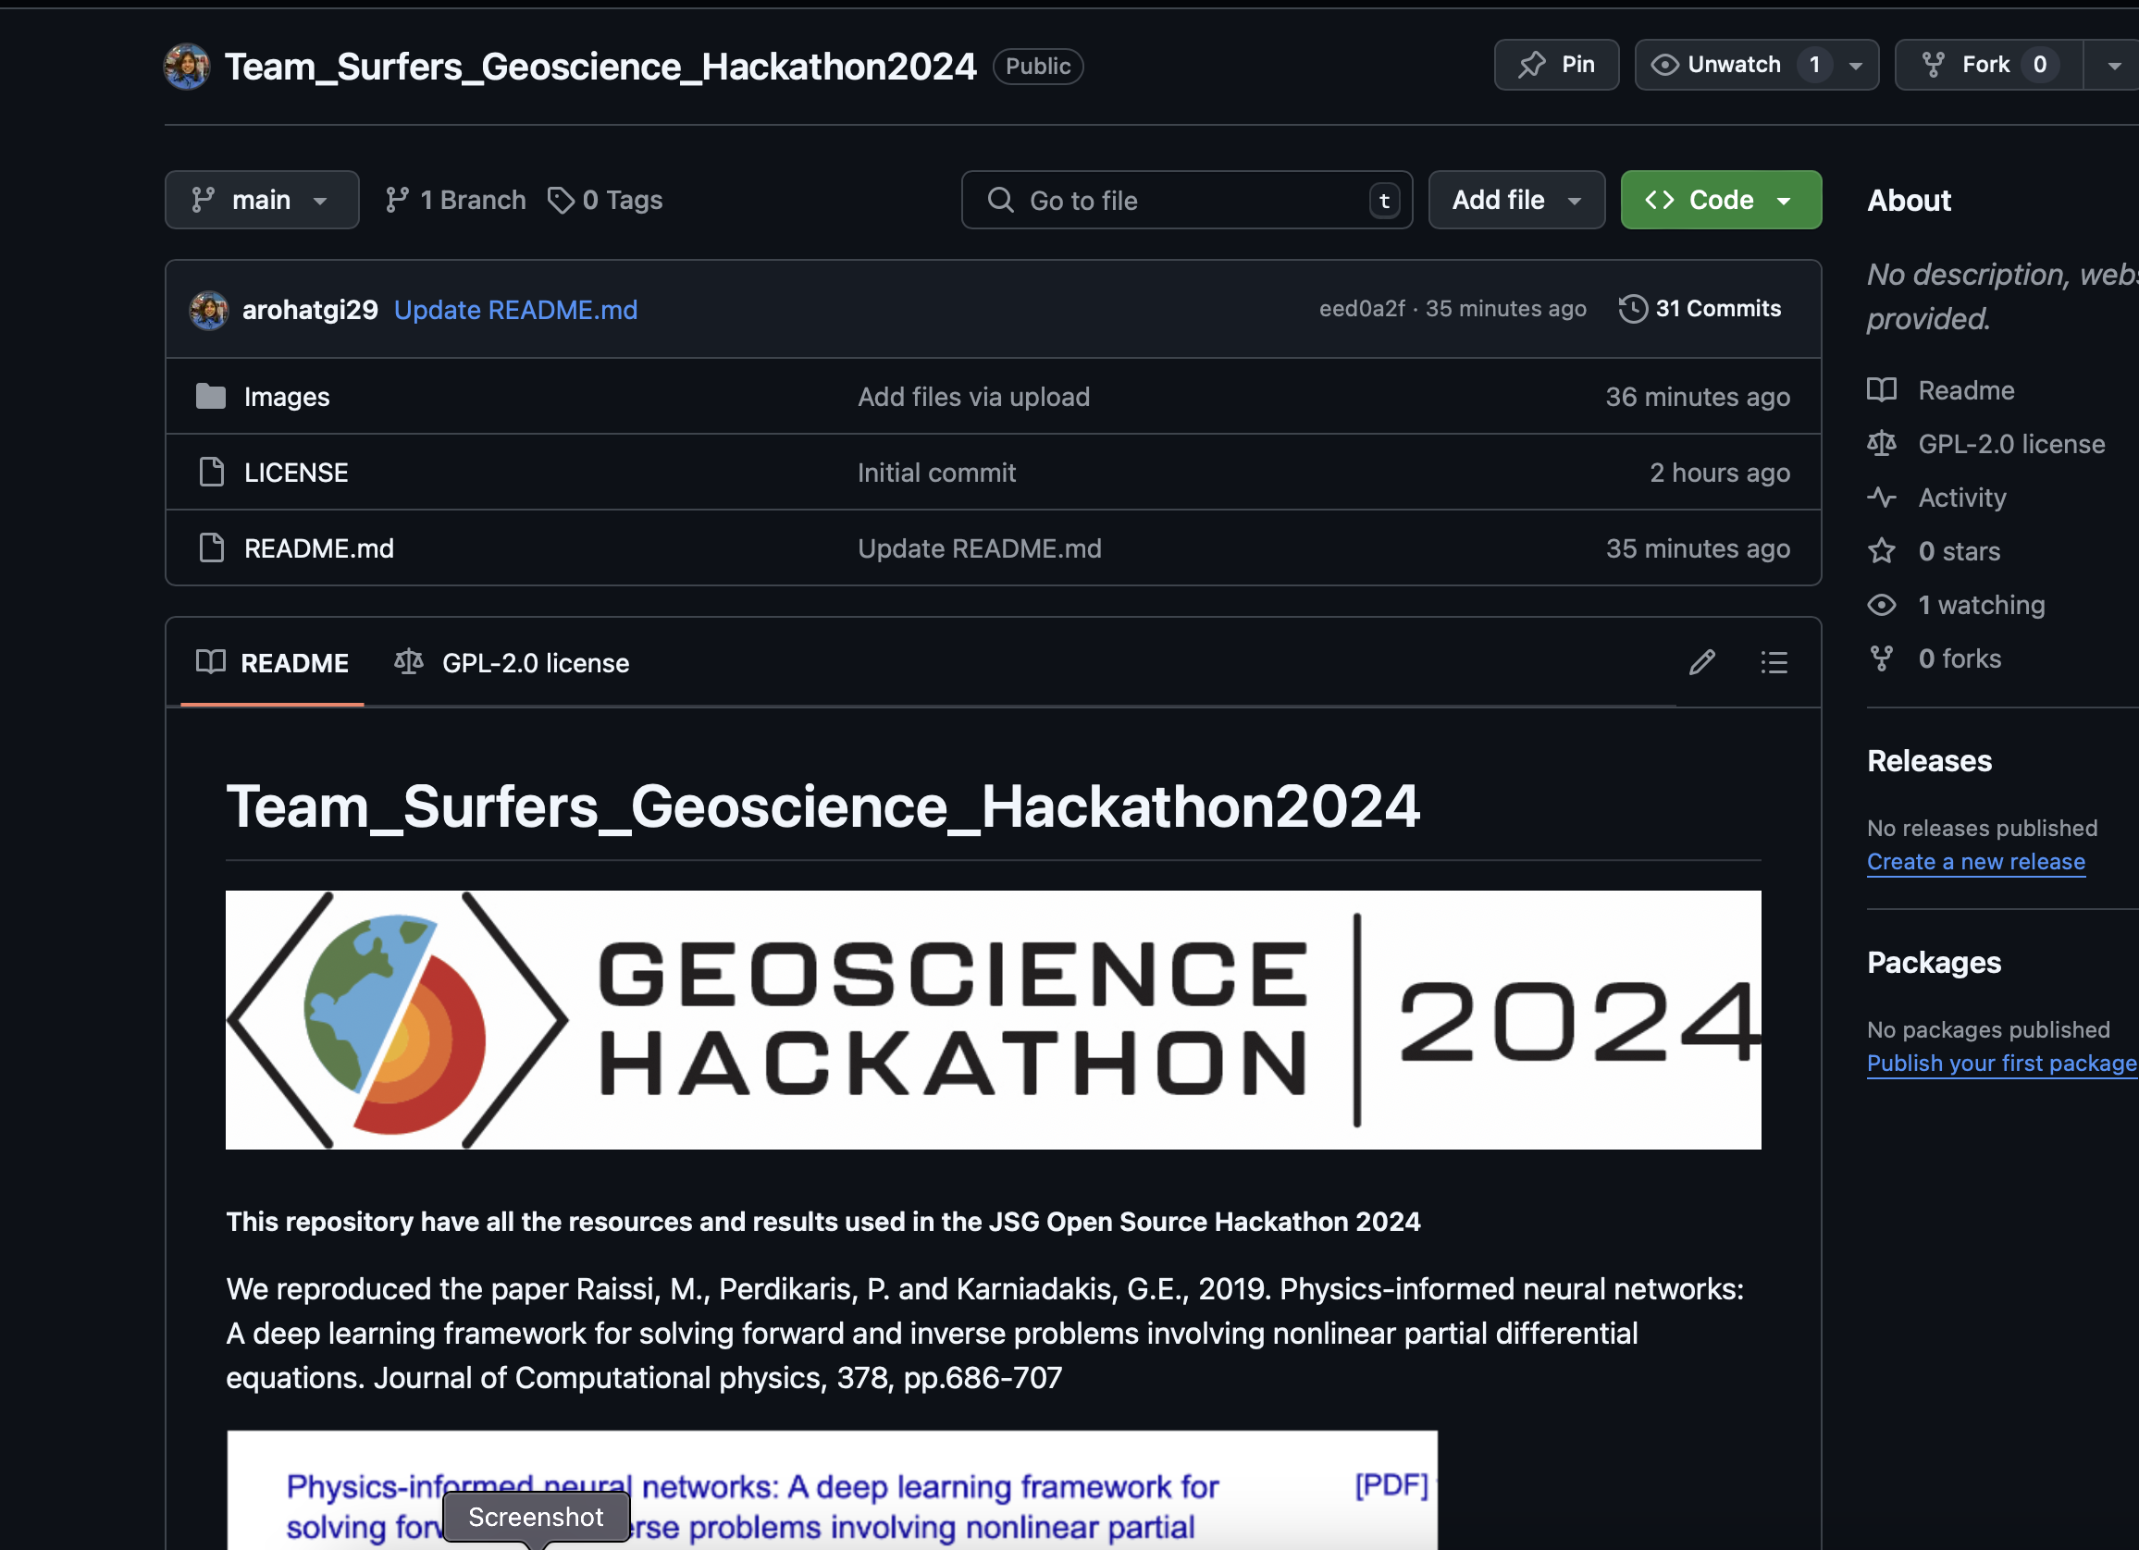
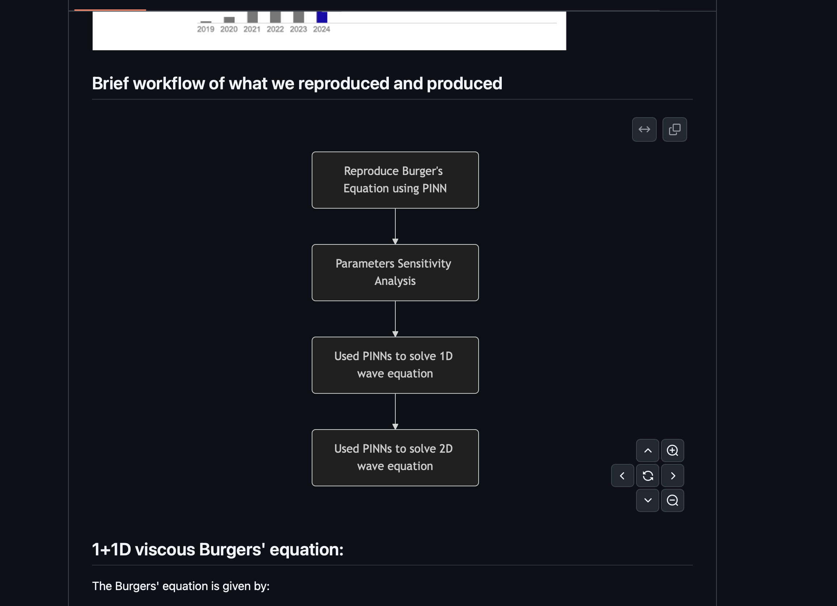

Slide 19
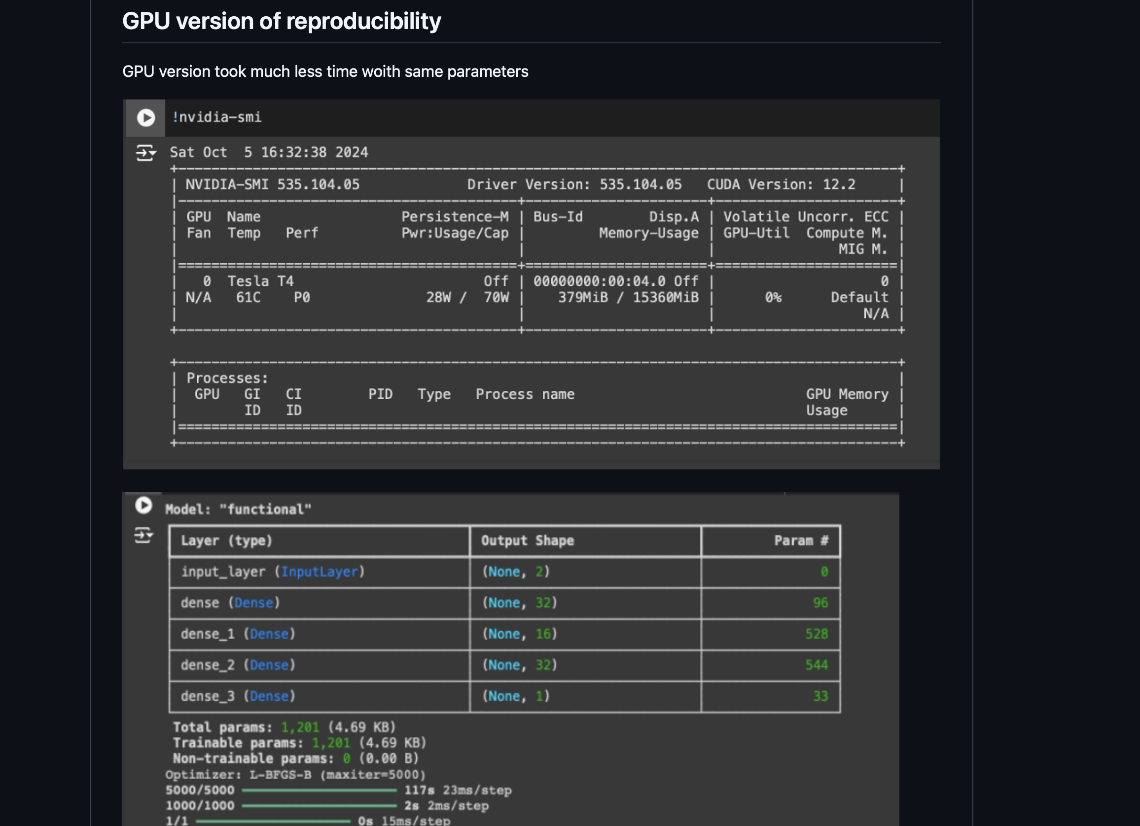
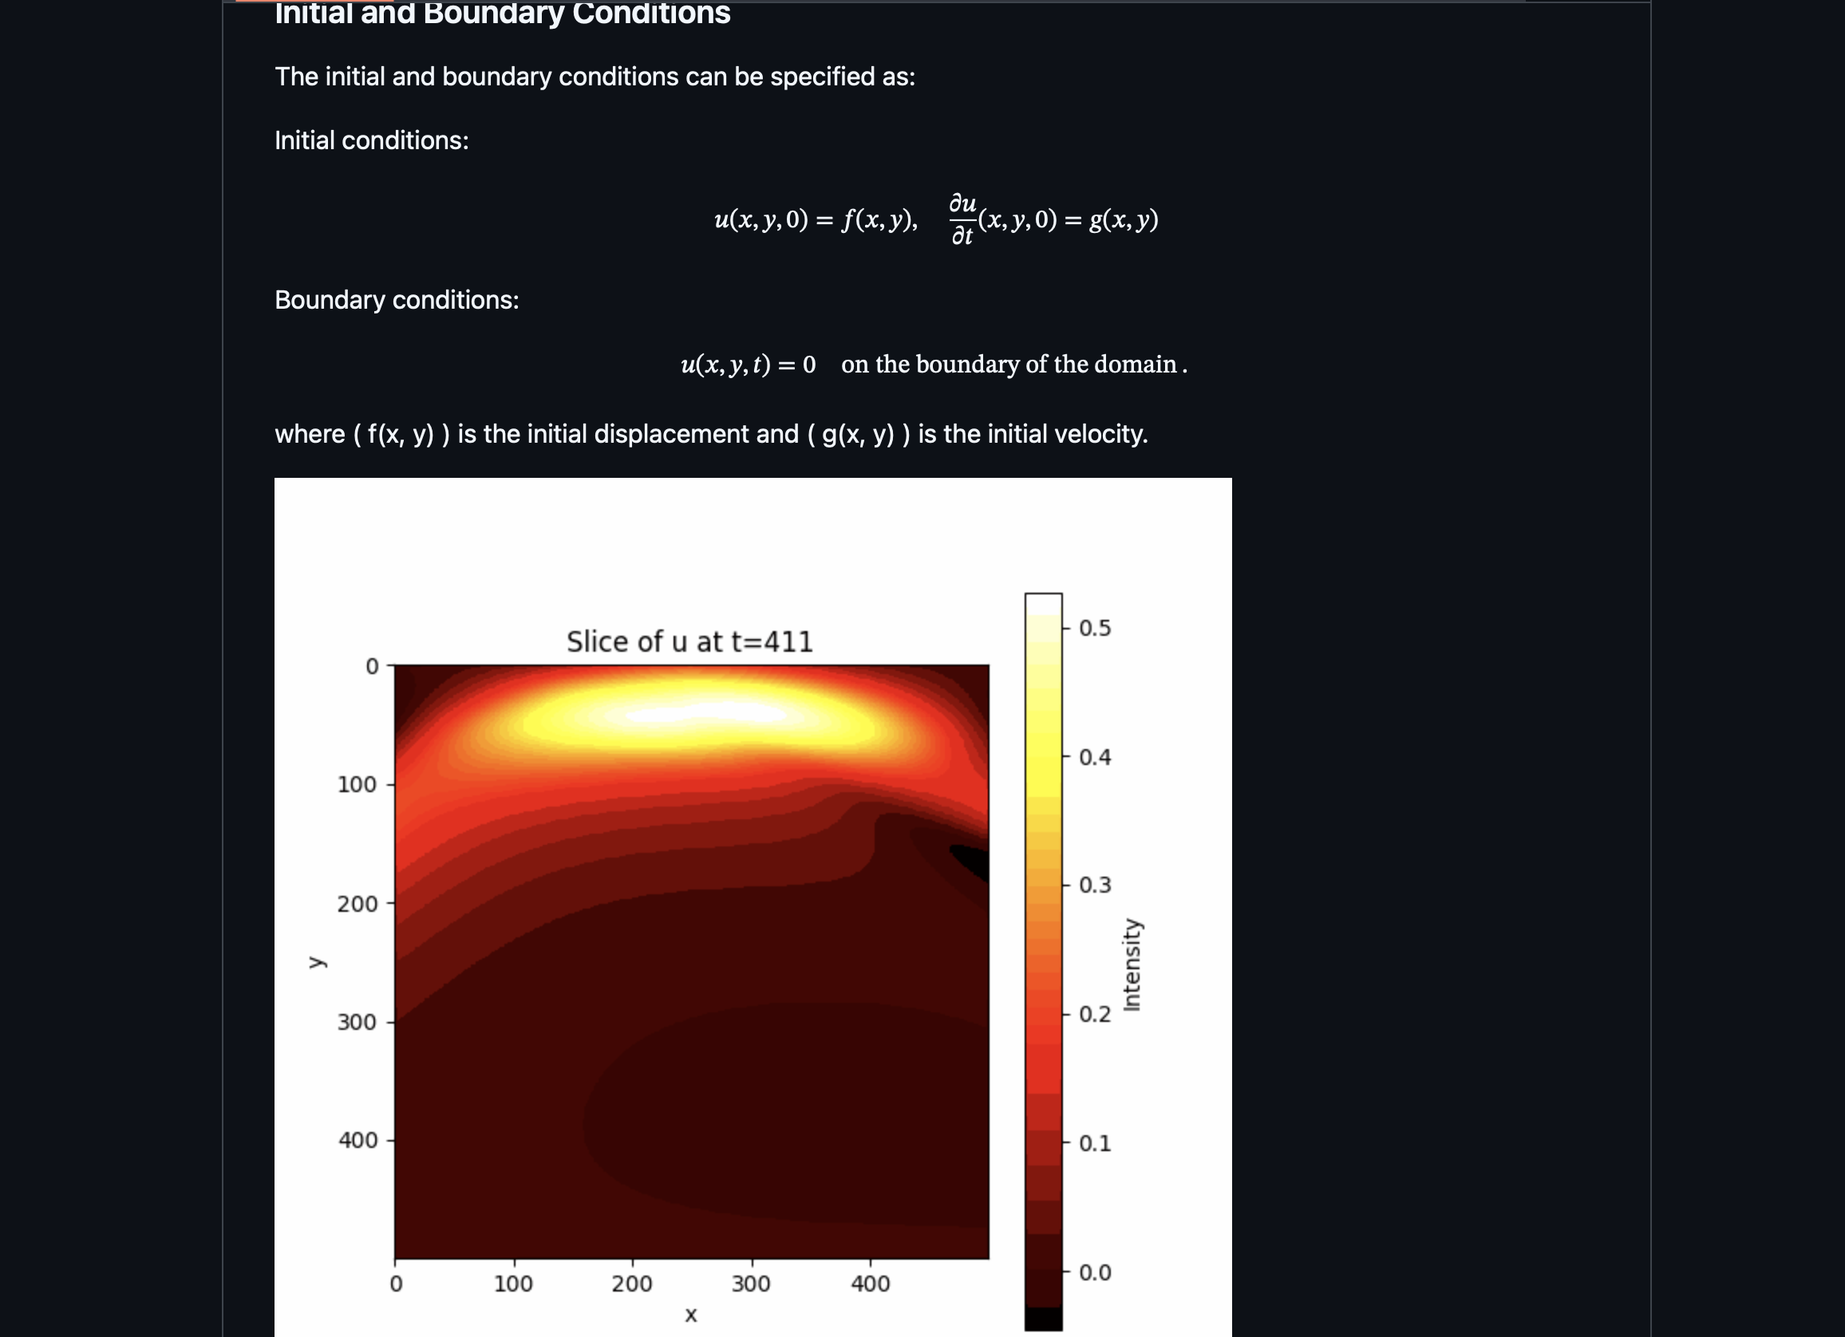

Slide 20
